Slide 1
HDAT9700
Missing data and multiple imputation
Online tutorial

Slide 2

Outline today
The problems caused by missing data
Tips for exploring missing data
Types of missing data
Single imputation methods
Multiple imputation
MI via iterative chained equations

Slide 3
The problem of missing data
Reduced N (equals wider variance)
Can be ameliorated by collecting more data
Often less of a concern in big data era (e.g. when using matching we happily throw away data to get better estimates)
Potential for bias
More concerning
Arises if individuals with missing data are different from those with complete data
Can be corrected, but needs observed data + assumptions

Slide 4
Activity
Missing data is not much of a problem if:
The proportion of missing data is small
There is no difference between individuals with missing data and complete data
See illustration in tutorial

Slide 5
Suggestions for exploring missing data
Before diving into complex methods like multiple imputation it is vital to have a good understanding of your data
What is your approach? Discuss!
Refer to existing documentation and talk to data custodians/users
Look at the proportion missing for each variable (is.na() function)
Look at proportion with complete cases versus 1 or more incomplete variables (mice::cci() function)
Check for trends or patterns in missing data (time/geography/key vars)
Compare complete background variables for complete versus incomplete cases

Slide 6

Missing data mechanisms
A taxonomy of three types of missing data
Missing Completely at Random (MCAR)
Missing not at random (MNAR)
Missing at Random (MAR)
Prof. Donald Rubin
(also proposed propensity score matching)
Image from harvard.edu
Notes:
I acknowledge these names are not helpful

Slide 7
Missing Completely at Random (MCAR)
The probability of being missing is independent of the data value
The missingness is truly “random”
e.g. a random sample of a Wave 1 cohort members were chosen for follow-up at wave 2
Complete case analysis has higher variance but unbiased!
Y Height
M Y Missing

Slide 8
Missing Not at Random (MNAR)
The probability of being missing does depend on the data
Missing cases are different to complete cases
e.g. Sicker participants might be more likely to drop out of an RCT
Complete case analysis will have higher variance and biased!
Y Height
M Y Missing

Slide 9
Missing at Random (MAR)
The probability of being missing is independent of the data value, conditional on the observed data
Missingness is random within categories defined by the observed variables
Complete case analysis is unbiased if you control for X
Most approaches to address missing data assume a MAR scenario
X Age + Sex + nationality
Y Height
M Y Missing

Slide 10
Review
Can you think of a practical example of each of these three scenarios?
1. Missing completely at random (MCAR)
Being observed or not is truly random in the conversational sense of random
2. Missing not at random (MNAR)
Being observed or not depends on the unobserved data
3. Missing at random (MAR)
Being observed or not depends on observed data.

Slide 11
Single imputation
Two models: imputation model and analysis model
Mean
Regression
Stochastic regression
Predictive mean matching
Last observation carried forward

Slide 12
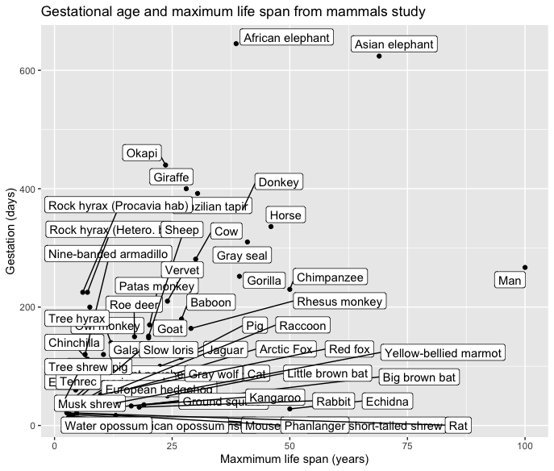
Single imputation methods
Illustrated using mammal sleep data from VIM (VIM::sleep) and mice packages (mice::mammalsleep)
Notes:
Before diving into multiple imputation I want to mention a few simpler types of imputation methods that you might come across. I’ll illustrate these using a small dataset with information on the interrelation between sleep and other variables for 62 mammal species. You can access this data in R in the VIM package where it is shipped as “sleep” or the mice package where it is shipped as mammalsleep. I’ve plotted a scatterplot of two of the variables here, gestation in days and life span in years. Here the labels are shown.

Slide 13
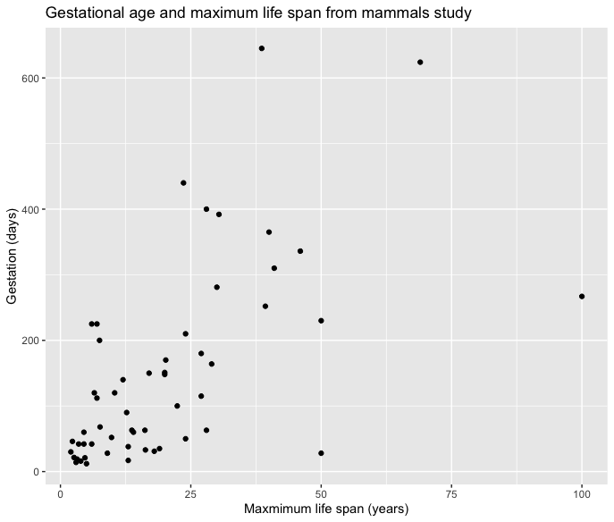
Single imputation methods
Illustrated using mammal sleep data from VIM (VIM::sleep) and mice packages (mice::mammalsleep)
Notes:
And here is a version without the labels, that makes it easier to see the data

Slide 14
Single imputation methods
Mean imputation
Notes:
The first simple imputation method I will mention is mean imputation. With mean imputation, every missing is value imputed with the mean of the observed data. The mean of lifespan for the observed values is about 20 years, so every missing value of life span would be filled in with 20 years. Similarly, the mean of gestation is about 150 days, so every missing value of gestation would be filled in with 150. This is a very simple and easy approach to implement, so it can be fine if you have very small proportions of missing data, but it is obviously very crude. One obvious point is that it ignores other information available in the data. For example, if a mammal had incomplete data for their lifespan, but we knew their gestation was very high then the observed data would suggest that the value for lifespan is likely to be higher than average.

Slide 15
Single imputation methods
Regression imputation
Notes:
Regression imputation is a more sophisticated alternative that allows us to incorporate information from the observed data when filling in missing observations. In this example, we could fit a model for lifespan conditional on gestation, and then use the predict line to make imputations for lifespan based on observed values for gestion. In this example there are just two variables but of course your imputation model could include as many variables as you have available.

Slide 16
Single imputation methods
Stochastic regression imputation
Notes:
Under regression imputation, the imputed values all lay on a regression line and that underestimates the variability in the data. Stochastic regression imputation overcomes this by adding some random noise to the predictions. This noise is drawn from a random distribution based on the estimated model parameters.

Slide 17
Single imputation methods
Predictive Mean Matching imputation
Notes:
The final single imputation method I will mention is Predictive Mean Matching. Under predictive mean matching, values from incomplete cases are replaced with observed values from similar complete cases.
To begin, a linear regression is used to estimate the predicted value of each incomplete observation.
Based on this predicted value, a set of candidate observations with similar value are selected.
From this pool of candidate donors, a single value is selected at random to be imputed for the missing observation
A key advantage of this approach is that the imputed values are always meaningful, because they are drawn from the actual data.

Slide 18



Visit Moodle to complete the myExperience survey or scan the QR code to complete on your phone
Tell us about your experience. Shape the future of education at UNSW.
Notes:
Things that have changed based on myExperience feedback: - Number and frequency of assessments.
Breadth of content and reading week.
Access to all readings and tutorials from week one.
I will respond to feedback items (in a general way) on Teams

Slide 19
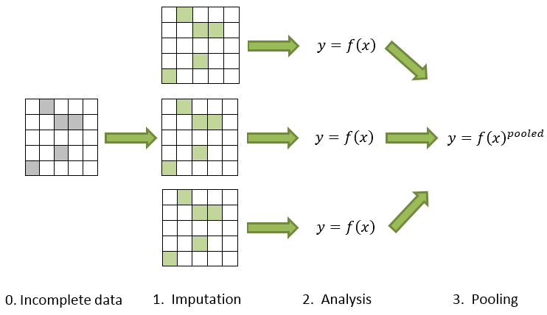
Multiple Imputation is a three-stage process
Notes:
Note there are two models here, the imputation model and the analysis model of interest

Slide 20
Rubin’s Rules for combining Estimates base on multiple imputation Point estimate of a parameter of interest: denoted Q
$$\overline{Q}= \frac{1}{m}\sum_{l=1}^{m}{{\hat{Q}}_{l}}$$
The average of the m estimates – easy!

Slide 21
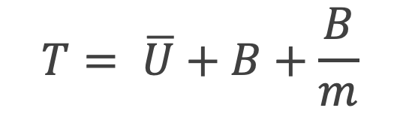
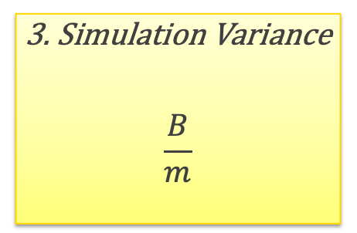
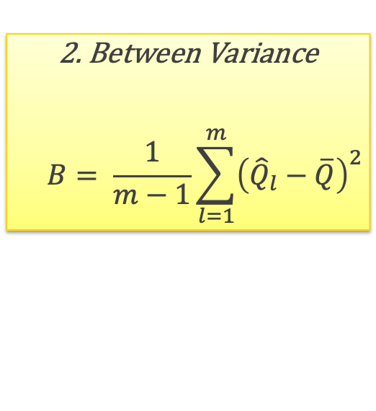
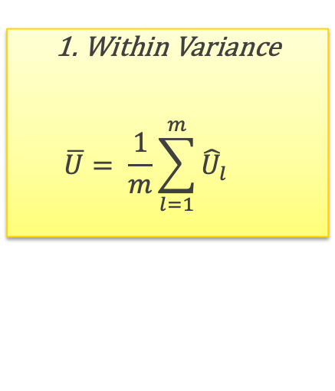
Rubin’s Rules for combining Estimates based on multiple imputation Variance of the parameter of interest: T
$$T= \overline{U}+B+\frac{B}{m}$$
1. Within Variance
$$\overline{U}= \frac{1}{m}\sum_{l=1}^{m}{{\hat{U}}_{l}}$$
2. Between Variance
$$B= \frac{1}{m−1}\sum_{l=1}^{m}{{\left({\hat{Q}}_{l}−\overline{Q}\right)}^{2}}$$
3. Simulation Variance
$$\frac{B}{m}$$
Average variance across m imputations
Variation of variance across m imputations
Accounts for finite m
Notes:
The total variance combines three sources of variation
The “within” variance i.e. the average variance for the estimate within each imputed dataset
The “between” variance i.e. the variation between estimates from different datasets
The “simulation” variance i.e. the variation due to a finite number of imputed datasets

Slide 22
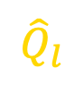


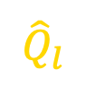
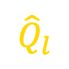

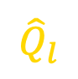

Rubin’s Rules for combining Estimates base on multiple imputation Variance of the parameter of interest: T
Low $\overline{U}$, Low B
Low $\overline{U}$, High B
$${\hat{Q}}_{l}$$
$${\hat{Q}}_{l}$$
1 2 3 4 5
1 2 3 4 5
imputation m
imputation m
High $\overline{U}$, Low B
High $\overline{U}$, High B
$${\hat{Q}}_{l}$$
$${\hat{Q}}_{l}$$
1 2 3 4 5
1 2 3 4 5
imputation m
imputation m

Slide 23
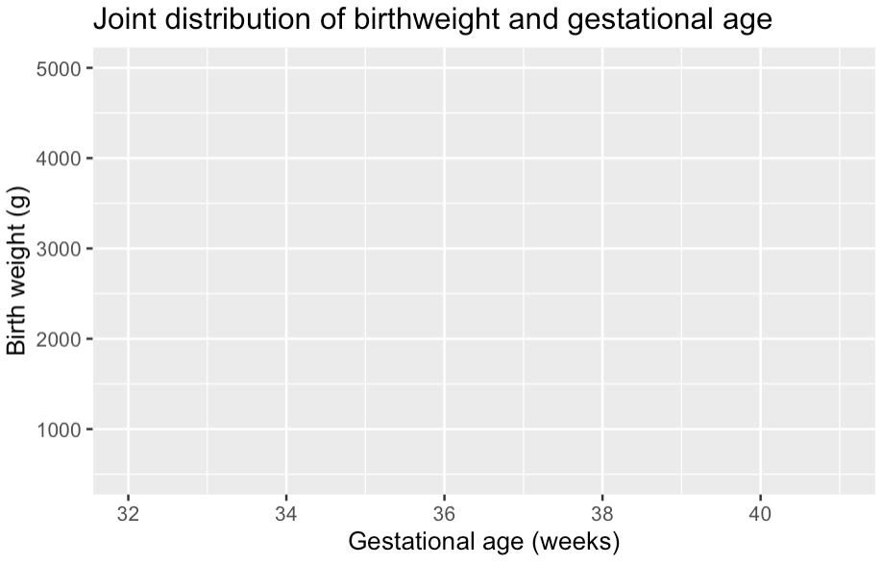
Iterative Chained Equations (ICE)
Why ICE?
Need to draw from joint distribution
Difficult when non-normal data or many different data types (binary, categorical, count etc)
ICE achieves draws from correct joint distribution by iteratively drawing from univariate distributions

Slide 24
Iterative Chained Equations (ICE)
How does it work?
Start by filling in all incomplete variables with some plausible value
Fit a model for each incomplete variable in turn, using all remaining variables as predictors.

Slide 25
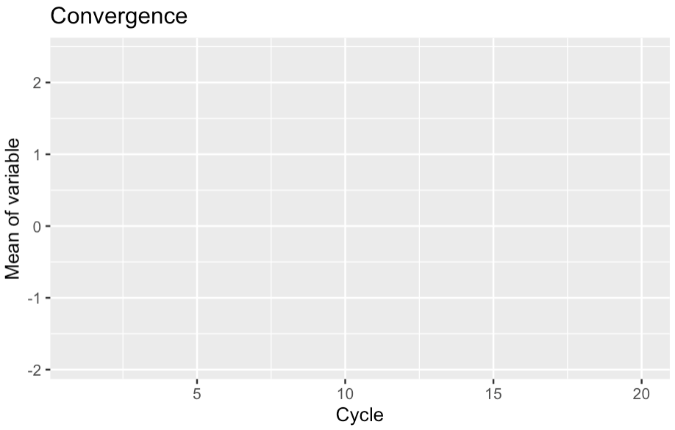
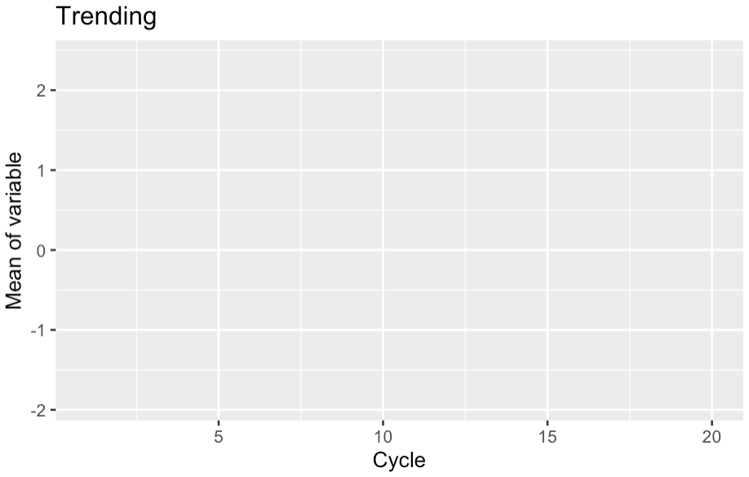
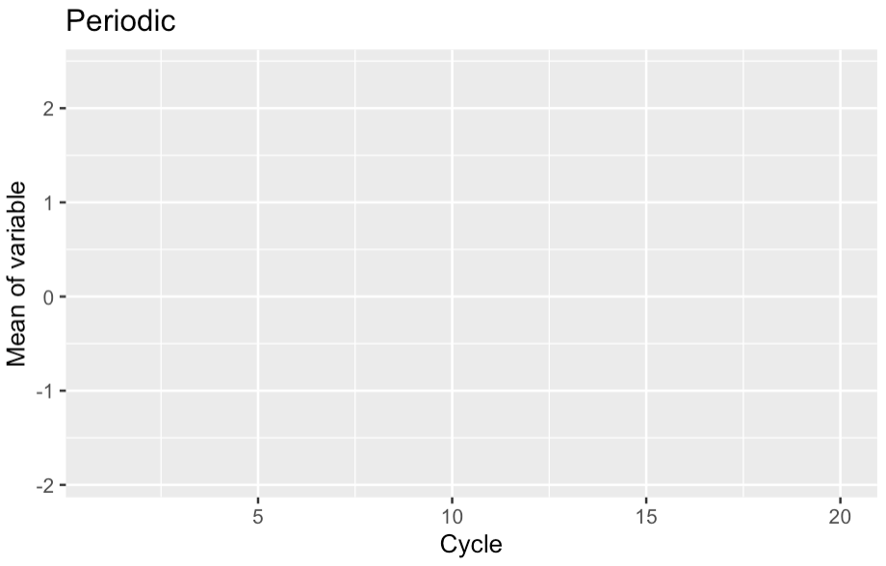
Iterative Chained Equations (ICE)
How many cycles?
Usually 10-20 are adequate
Examine trace plot for convergence
On convergence:
No trends
Free mixing across parameter space

Slide 26
Iterative Chained Equations (ICE)
Features and advantages
Valid imputations from intractable multivariate distributions
Specify the appropriate model type for each variable
Tailor model predictors (minimise noise & overfitting, e.g. time series data)
Passive imputation (maintain fixed relationships e.g. BMI)
Conditional imputation (e.g. # cigarettes per day only for smokers)

Slide 27
Reporting the results of multiple imputation
For an example of how to report the methods and results for a regression analysis please see Supplement A Missing Data and Multiple Imputation in
Hanly M, Falster K, Banks E, et al. Role of maternal age at birth in child development among Indigenous and non-Indigenous Australian children in their first school year: a population-based cohort study. Lancet Child Adolesc Health 2019 http://dx.doi.org/10.1016/S2352-4642(19)30334-7.
Link to supplement here: https://ars.els-cdn.com/content/image/1-s2.0-S2352464219303347-mmc1.pdf

Slide 28
Summary
Missing data can increase variance and bias in model estimates
The magnitude of bias depends on the % missing data and the association between the parameter of interest and the probability of being missing
Need to understand mechanisms leading to missing data
Talk to data custodians!
Summarise patterns of missing data
Single imputation ok for small % missing data
Multiple imputation
Impute multiple times (Usually 5-20)
Estimate model in each complete dataset
Average model estimates

